Slide 1
LIFE OF CHRIST

Slide 2
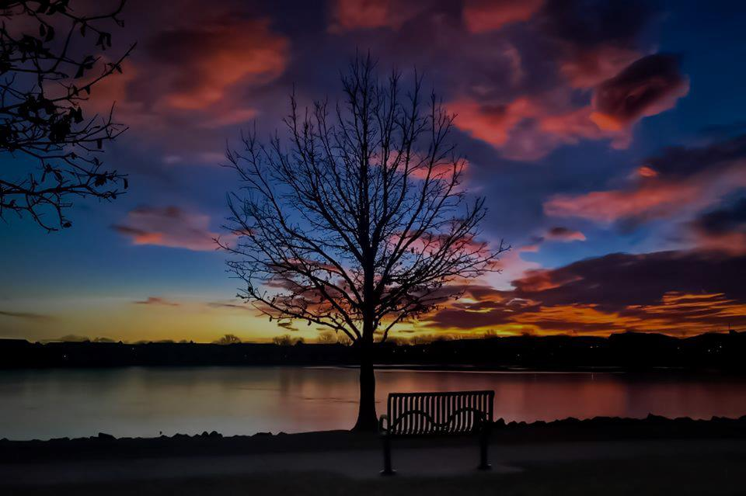
John 12:9 Now a great many of the Jews knew that He was there; and they came, not for Jesus' sake only, but that they might also see Lazarus, whom He had raised from the dead. ¹⁰ But the chief priests plotted to put Lazarus to death also, ¹¹ because on account of him many of the Jews went away and believed in Jesus.

Slide 3
Matthew 21, Mark 11, Luke 19, and John 12

Slide 4
Matthew 21:1 Now when they drew near Jerusalem, and came to Bethphage (and Bethany [Mk. and Lk.]), at the Mount of Olives, then Jesus sent two disciples, ² saying to them, "Go into the village opposite you, and immediately you will find a donkey tied, and a colt with her (on which no one has sat. [Mk. and Lk.]) Loose them and bring them to Me. ³ "And if anyone says anything to you, you shall say, 'The Lord has need of them,' and immediately he will send them." ⁴ All this was done that it might be fulfilled which was spoken by the prophet, saying:

Slide 5
⁵ "Tell the daughter of Zion, 'Behold, your King is coming to you, Lowly, and sitting on a donkey, A colt, the foal of a donkey.' " ⁶ So the disciples went and did as Jesus commanded them. (Mark 11: ⁴ So they went their way, and found the colt tied by the door outside on the street, and they loosed it. ⁵ But some of those who stood there said to them, "What are you doing, loosing the colt?" ⁶ And they spoke to them just as Jesus had commanded. Luke 19:34 And they said, "The Lord has need of him." So they let them go.) ⁷ They brought the donkey and the colt, laid their clothes on them, and set Him on them.

Slide 6
John 12:12 The next day a great multitude that had come to the feast, when they heard that Jesus was coming to Jerusalem, ¹³ took branches of palm trees and went out to meet Him, and cried out: "Hosanna! 'Blessed is He who comes in the name of the LORD!' The King of Israel!"

Slide 7
Matthew 21:8 And a very great multitude spread their clothes on the road; others cut down branches from the trees and spread them on the road. ⁹ Then the multitudes who went before and those who followed cried out, saying: "Hosanna to the Son of David! 'Blessed is He who comes in the name of the LORD!' Hosanna in the highest!" ¹⁰ And when He had come into Jerusalem, all the city was moved, saying, "Who is this?" ¹¹ So the multitudes said, "This is Jesus, the prophet from Nazareth of Galilee.“

Slide 8
Mark 11:8 And many spread their clothes on the road, and others cut down leafy branches from the trees and spread them on the road. ⁹ Then those who went before and those who followed cried out, saying: "Hosanna! 'Blessed is He who comes in the name of the LORD!' ¹⁰ Blessed is the kingdom of our father David That comes in the name of the Lord! Hosanna in the highest!"

Slide 9
Luke 19:36 And as He went, many spread their clothes on the road. ³⁷ Then, as He was now drawing near the descent of the Mount of Olives, the whole multitude of the disciples began to rejoice and praise God with a loud voice for all the mighty works they had seen, ³⁸ saying: " 'Blessed is the King who comes in the name of the LORD!' Peace in heaven and glory in the highest!"

Slide 10
From the time of the Maccabees palms or palm-branches had been used as a national symbol. Palm-branches figured in the procession which celebrated the rededication of the temple in 164 BC (2 Macc. 10:7) and again when the winning of full political independence was celebrated under Simon in 141 BC (1 Macc. 13:51)… On this occasion, then, the palm-branches may have signified the people’s expectation of the imminent national liberation, and this is supported by the words with which they greeted the Lord (F.F. Bruce The Gospel and Epistles of John p. 259).

Slide 11
Hosanna literally means “help” or “save, I pray” (BDAG).

Slide 12
John 12:14 Then Jesus, when He had found a young donkey, sat on it; as it is written: ¹⁵ "Fear not, daughter of Zion; Behold, your King is coming, Sitting on a donkey's colt."

Slide 13
Zechariah 9:9 " Rejoice greatly, O daughter of Zion! Shout, O daughter of Jerusalem! Behold, your King is coming to you; He is just and having salvation, Lowly and riding on a donkey, A colt, the foal of a donkey. ¹⁰ I will cut off the chariot from Ephraim And the horse from Jerusalem; The battle bow shall be cut off. He shall speak peace to the nations; His dominion shall be 'from sea to sea, And from the River to the ends of the earth.'

Slide 14
Kings … would enter upon an ass or mule, which was symbolic of their humility and their desire to be at peace with their subjects. It was not appropriate for a king to enter a city upon a horse, but rather to enter meekly and humbly upon an ass. Jesus is the king of His kingdom, the church. It was appropriate for Him to enter the holy city the way that a king would enter it, riding upon an ass (Denton Lectures electronic edition on John).

Slide 15
Mat. 21:5 "Tell the daughter of Zion, 'Behold, your King is coming to you, Lowly, and sitting on a donkey, A colt, the foal of a donkey.' " ⁶ So the disciples went and did as Jesus commanded them. ⁷ They brought the donkey and the colt, laid their clothes on them, and set Him on them.

Slide 16
The explanation is found in Luke's account in Luke 19:30, when he says "whereon yet never man sat." Luke is describing a young animal still attached to his mother. They are linked together because of their mother-and-son relationship. The Lord would be riding a young, untamed colt, still closely attached to its mother, which is the reason the Lord needed them both, even though he would ride the young colt only. The mother would provide the comfort and support to allow this young animal to perform his important task (Denton Lectures electronic edition on John).

Slide 17
John 12:16 His disciples did not understand these things at first; but when Jesus was glorified, then they remembered that these things were written about Him and that they had done these things to Him.

Slide 18
John 12:17 Therefore the people, who were with Him when He called Lazarus out of his tomb and raised him from the dead, bore witness. ¹⁸ For this reason the people also met Him, because they heard that He had done this sign. ¹⁹ The Pharisees therefore said among themselves, "You see that you are accomplishing nothing. Look, the world has gone after Him!"

Slide 19
Luke 19:39 And some of the Pharisees called to Him from the crowd, "Teacher, rebuke Your disciples." ⁴⁰ But He answered and said to them, "I tell you that if these should keep silent, the stones would immediately cry out."

Slide 20
Luke 19:41 Now as He drew near, He saw the city and wept over it, ⁴² saying, "If you had known, even you, especially in this your day, the things that make for your peace! But now they are hidden from your eyes. ⁴³ "For days will come upon you when your enemies will build an embankment around you, surround you and close you in on every side, ⁴⁴ "and level you, and your children within you, to the ground; and they will not leave in you one stone upon another, because you did not know the time of your visitation."

Slide 21
The summit of Olivet is two hundred feet higher than the nearest part of the city of Jerusalem and a hundred feet higher than its farthest part, so that the Lord looked upon the whole of it as one looks upon an open book. As he looked upon it he realized the difference between what his coming might mean to it and what it did mean to it; between the love and gratitude which his coming should have incited and the hatred and violence which it did incite; between the forgiveness, blessing, and peace which he desired to bring it and the judgment, wrath, and destruction which were coming upon it. The vision of it all excited strong emotion, and the verb used does not indicate silent tears, but audible sobbing and lamentation.

Slide 22
⁴² saying, "If you had known, even you, especially in this your day, the things that make for your peace! But now they are hidden from your eyes. ⁴³ "For days will come upon you when your enemies will build an embankment around you, surround you and close you in on every side, ⁴⁴ "and level you, and your children within you, to the ground; and they will not leave in you one stone upon another, because you did not know the time of your visitation."

Slide 23
Mark 11:11 And Jesus went into Jerusalem and into the temple. So when He had looked around at all things, as the hour was already late, He went out to Bethany with the twelve. ¹² Now the next day, when they had come out from Bethany, He was hungry. ¹³ And seeing from afar a fig tree having leaves, He went to see if perhaps He would find something on it. When He came to it, He found nothing but leaves, for it was not the season for figs. ¹⁴ In response Jesus said to it, "Let no one eat fruit from you ever again." And His disciples heard it.

Slide 24
McGarvery says? “The fact it was not yet fig time made it worse for this tree. On this kind of tree the fruit forms before the leaves, and should be full grown before the leaves appear: so this tree, by putting on its foliage before the time for figs, was proclaiming itself superior to all the other fig trees. This made it a striking symbol of the hypocrite, who, not content with appearing to be as good as other people, usually puts on the appearance of being a great deal better.”

Slide 25
It was barren, and therefore worthless. This was the point Jesus was emphasizing and from which he drew his lesson. Its signs were false, it general appearance was deceptive. It was thus an emblem of the hypocrite, and particularly of the Jewish people, with their high professions, their show of ritual and formal worship, without the fruits of righteousness (Jer. 2:21; Luke 13:6-9). The Jews professed to be worshippers of God – they had all the outside appearance – all the signs, but they were barren of the fruits of righteousness. This was the point Jesus drove home to the Jews. (Gospel Advocate – Mark p. 264).

Slide 26
Luke 13:6 He also spoke this parable: "A certain man had a fig tree planted in his vineyard, and he came seeking fruit on it and found none. ⁷ "Then he said to the keeper of his vineyard, 'Look, for three years I have come seeking fruit on this fig tree and find none. Cut it down; why does it use up the ground?' ⁸ "But he answered and said to him, 'Sir, let it alone this year also, until I dig around it and fertilize it. ⁹ 'And if it bears fruit, well. But if not, after that you can cut it down.' "

Slide 27
Matthew 21:12 Then Jesus went into the temple of God and drove out all those who bought and sold in the temple, and overturned the tables of the money changers and the seats of those who sold doves. ¹³ And He said to them, "It is written, 'My house shall be called a house of prayer,' but you have made it a 'den of thieves.' "
Mark 11:16 And He would not allow anyone to carry wares through the temple.

Slide 28
Deuteronomy 14:24 "But if the journey is too long for you, so that you are not able to carry the tithe, or if the place where the LORD your God chooses to put His name is too far from you, when the LORD your God has blessed you, ²⁵ "then you shall exchange it for money, take the money in your hand, and go to the place which the LORD your God chooses. ²⁶ "And you shall spend that money for whatever your heart desires: for oxen or sheep, for wine or similar drink, for whatever your heart desires; you shall eat there before the LORD your God, and you shall rejoice, you and your household.

Slide 29
Matthew 21:14 Then the blind and the lame came to Him in the temple, and He healed them. ¹⁵ But when the chief priests and scribes saw the wonderful things that He did, and the children crying out in the temple and saying, "Hosanna to the Son of David!" they were indignant ¹⁶ and said to Him, "Do You hear what these are saying?" And Jesus said to them, "Yes. Have you never read, 'Out of the mouth of babes and nursing infants You have perfected praise'?"

Slide 30
Mark 11:18 And the scribes and chief priests heard it and sought how they might destroy Him; for they feared Him, because all the people were astonished at His teaching.
Luke. 19:47 And He was teaching daily in the temple. But the chief priests, the scribes, and the leaders of the people sought to destroy Him, 48 and were unable to do anything; for all the people were very attentive to hear Him.

Slide 31
Matthew 21: 17 Then He left them and went out of the city to Bethany, and He lodged there.

